Slide 1
Graphs
CSCI 4360/6360 Data Science II

Slide 2
Why graphs?
Lots of data is graphs
Facebook, Twitter, citation data, and other social networks
The web, the blogosphere, the semantic web, Freebase, Wikipedia, Twitter, and other information networks
Text corpora (like RCV1), large datasets with discrete feature values, and other bipartite networks
nodes = documents or words
links connect document → word or word → document
Computer networks, biological networks (proteins, ecosystems, brains, …), …
Heterogeneous networks with multiple types of nodes
people, groups, documents

Slide 3
Properties of Graphs
Nodes & Edges
Set V of vertices/nodes v1, …
Set E of edges (u,v),…
Can be weighted/directed/labeled
Degree of v is # of edges on v
Indegree and outdegree for weighted graphs
Path is a sequence of edges (u1,v1),(u2,v2),…
Geodesic path between u and v is shortest path connecting them
Diameter is max _{u,v in V} {length of geodesic between u,v}
Effective diameter is 90th percentile
Mean diameter is over connected pairs
(Connected) component is subset of nodes that are all pairwise connected via paths
Clique is subset of nodes that are all pairwise connected via edges
Triangle is a clique of size three

Slide 4
Properties of Graphs
Descriptive statistics
Number of connected components
Diameter
Degree distribution
Centrality
…

Slide 5
Properties of Graphs
Models of formation and growth
Erdos-Rayni
Watts-Strogatz
Preferential attachment
Stochastic block models
…

Slide 6
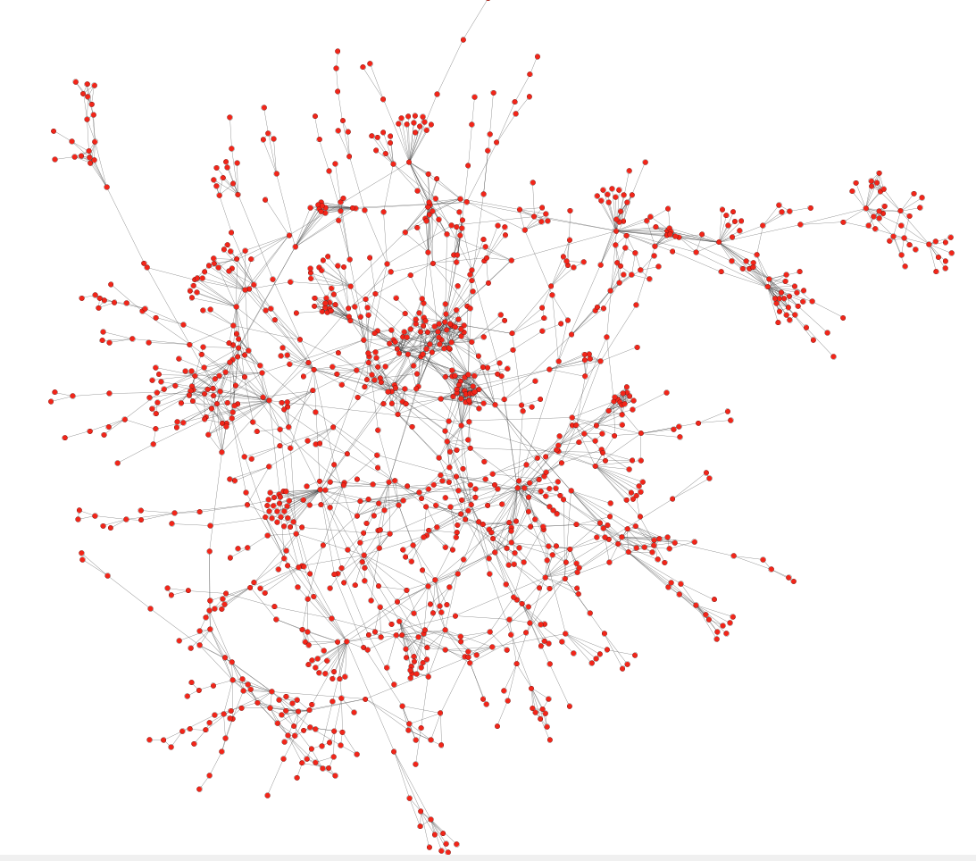
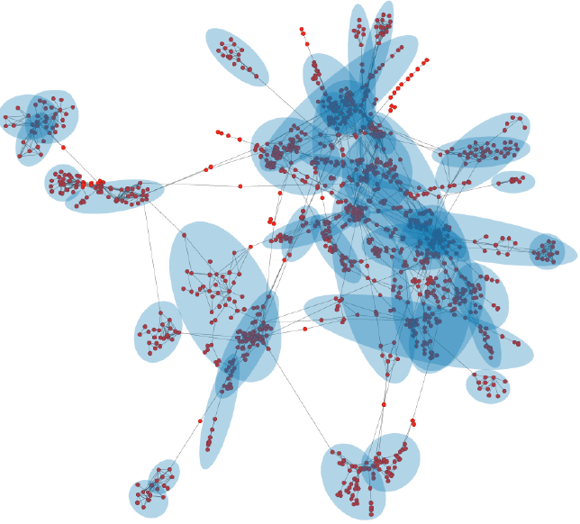
Biology
Can we identify functional modules?
Protein-protein interaction networks
Nodes: proteins
Edges: interactions
Functional modules

Slide 7
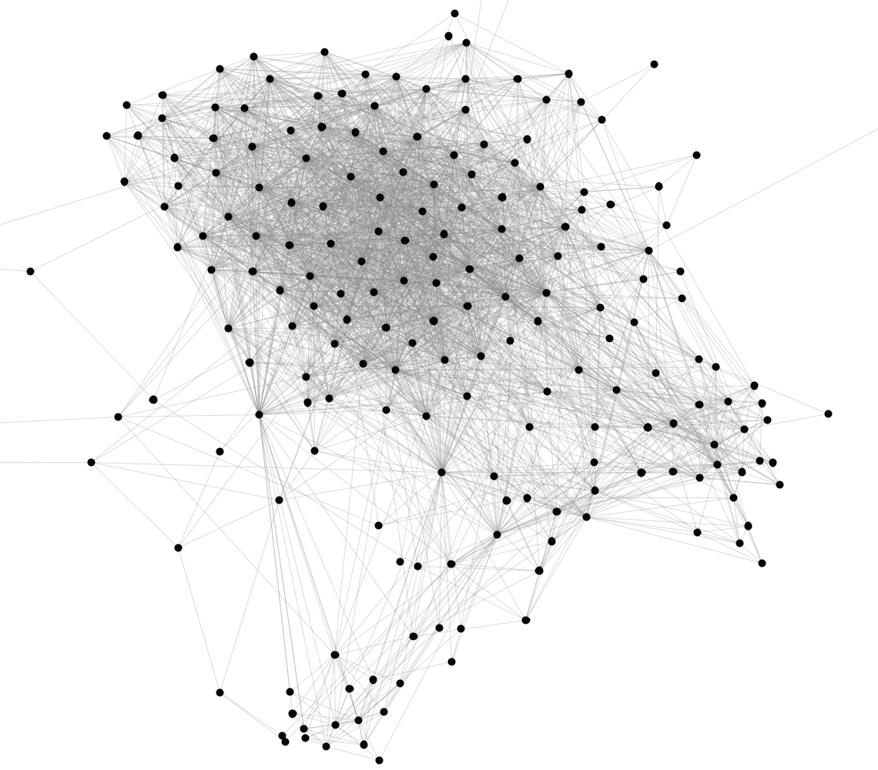
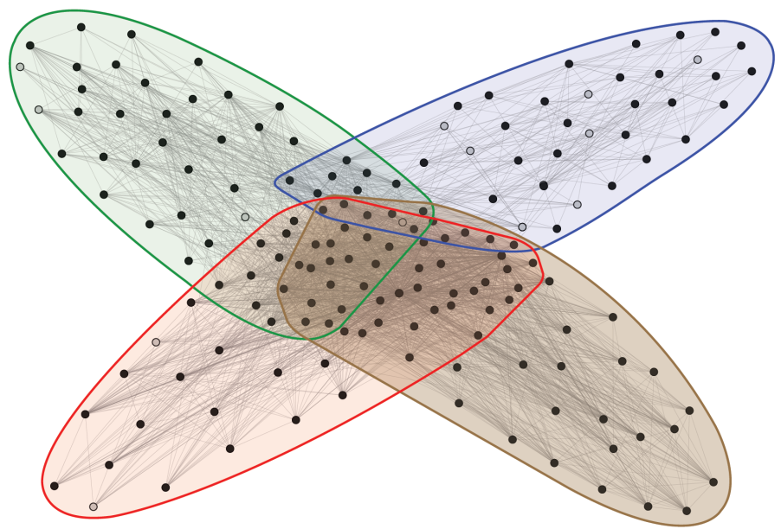
Facebook
Can we identify social communities?
Social communities
Nodes: Facebook users
Edges: Friendships
Social communities
High school
Summer internship
Stanford (Basketball)
Stanford (Squash)

Slide 8
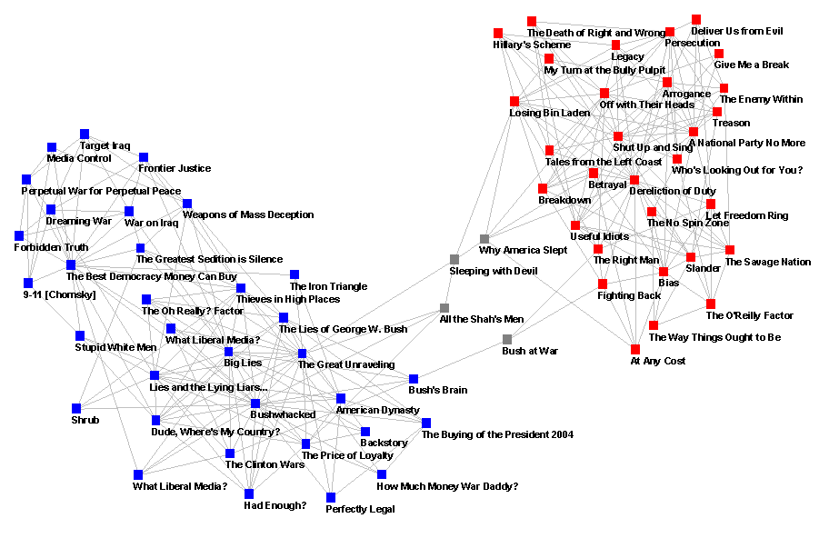
Blogs

Slide 9
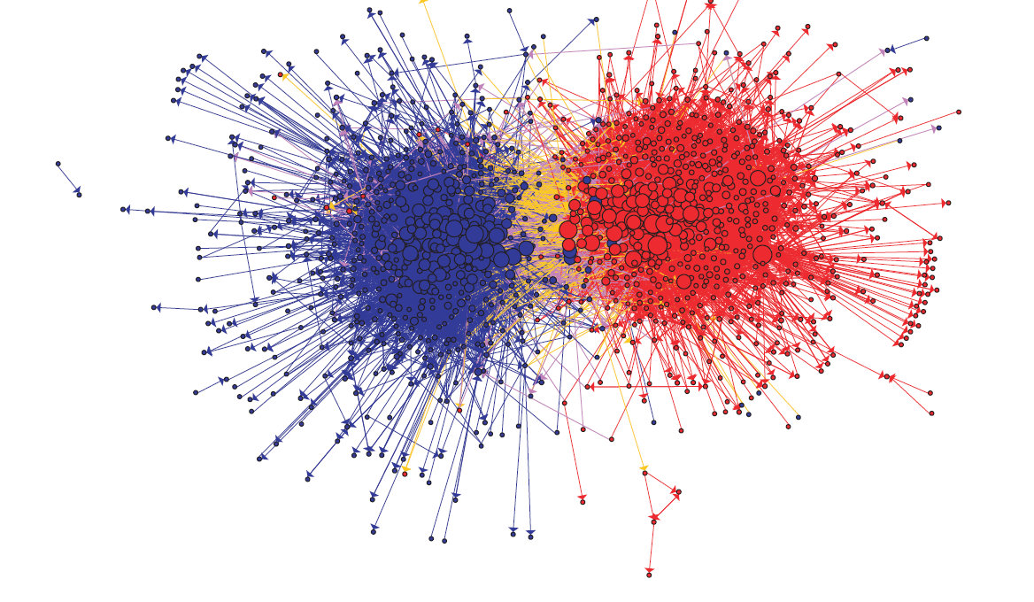
Blogs

Slide 10
Erdos-Renyi graphs
Take n nodes, and connect each pair with probability p
Mean degree is z=p(n-1)

Slide 11
Erdos-Renyi graphs
Take n nodes, and connect each pair with probability p
Mean degree is z=p(n-1)
Mean number of neighbors distance d from v is z^{d}
How large does d need to be so that z^{d} >=n ?
If z>1, d = log(n)/log(z)
If z<1, you can’t do it
So:
There tend to be either many small components (z<1) or one large one (z>1) giant connected component)
Another intuition:
If there are a two large connected components, then with high probability a few random edges will link them up.

Slide 12
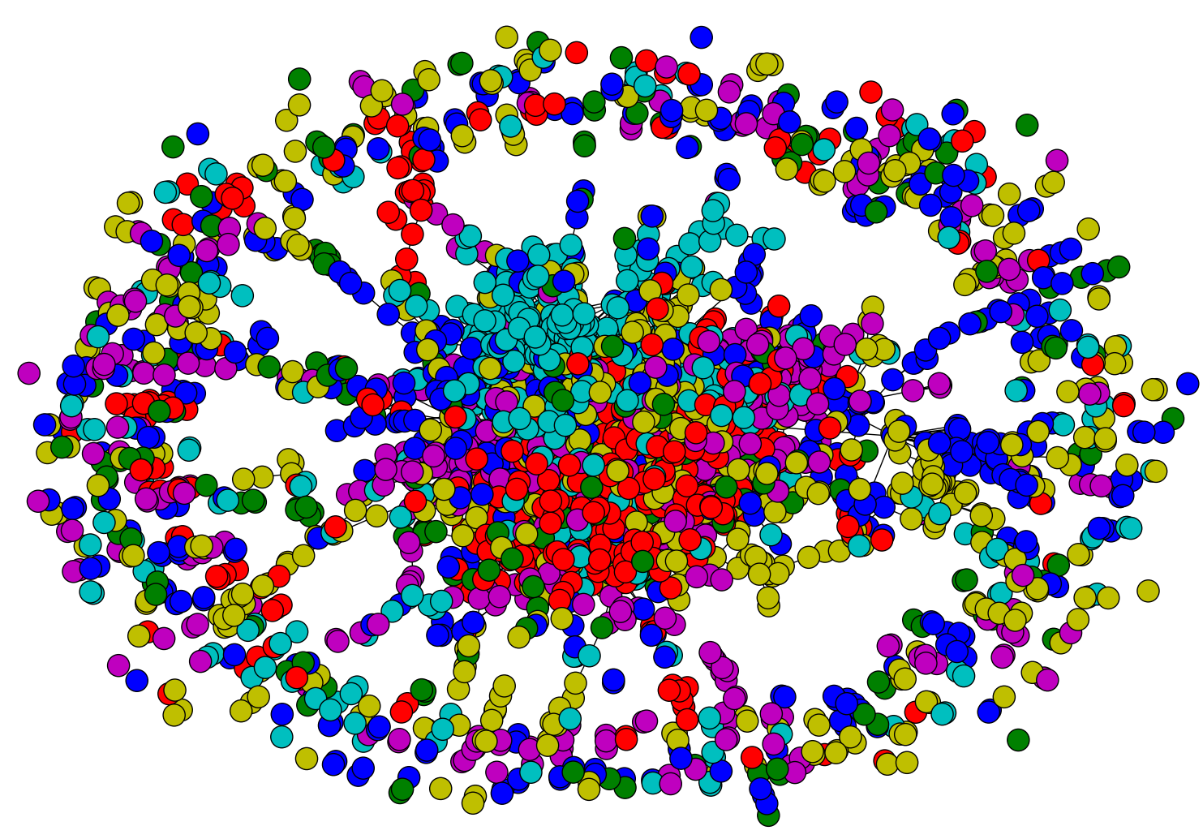

Slide 13
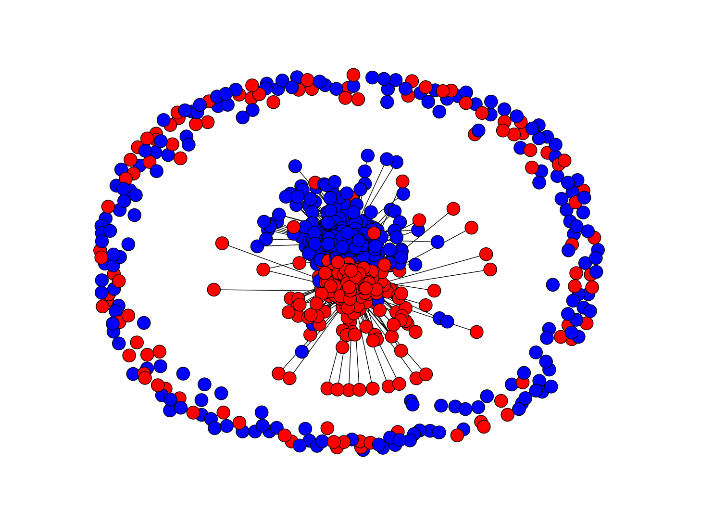
Notes:
blogs

Slide 14
Erdos-Renyi graphs
Take n nodes, and connect each pair with probability p
Mean degree is z=p(n-1)
Mean number of neighbors distance d from v is z^{d}
How large does d need to be so that z^{d} >=n ?
If z>1, d = log(n)/log(z)
If z<1, you can’t do it
So:
If z>1, diameters tend to be small (relative to n)

Slide 15
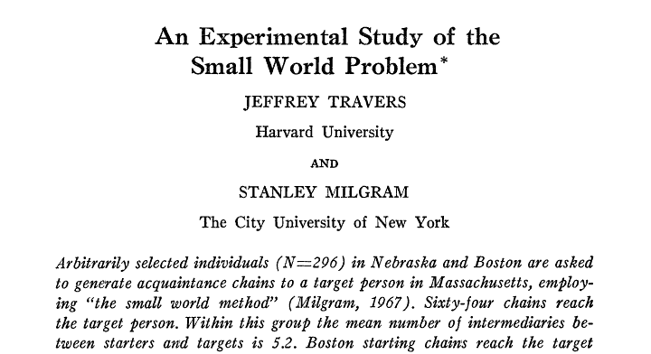
Sociometry, Vol. 32, No. 4. (Dec., 1969), pp. 425-443.
64 of 296 chains succeed, avg chain length is 6.2

Slide 16
Illustrations of the Small World
Milgram’s experiment
Erdős numbers
http://www.ams.org/mathscinet/searchauthors.html
Bacon numbers
http://oracleofbacon.org/
LinkedIn
http://www.linkedin.com/
Privacy issues: the whole network is not visible to all

Slide 17
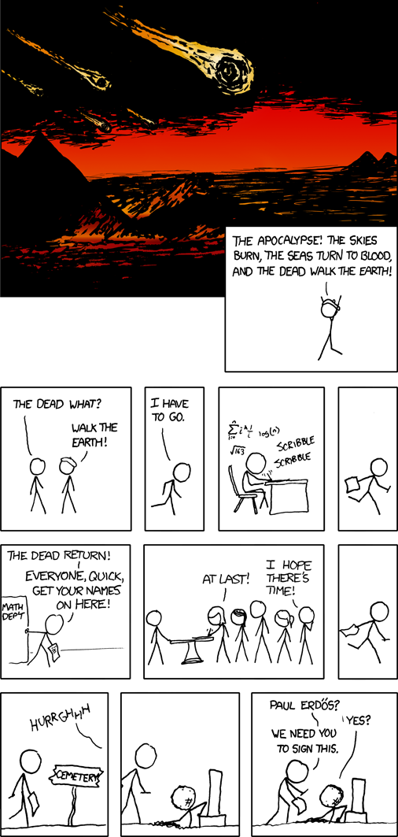

Slide 18
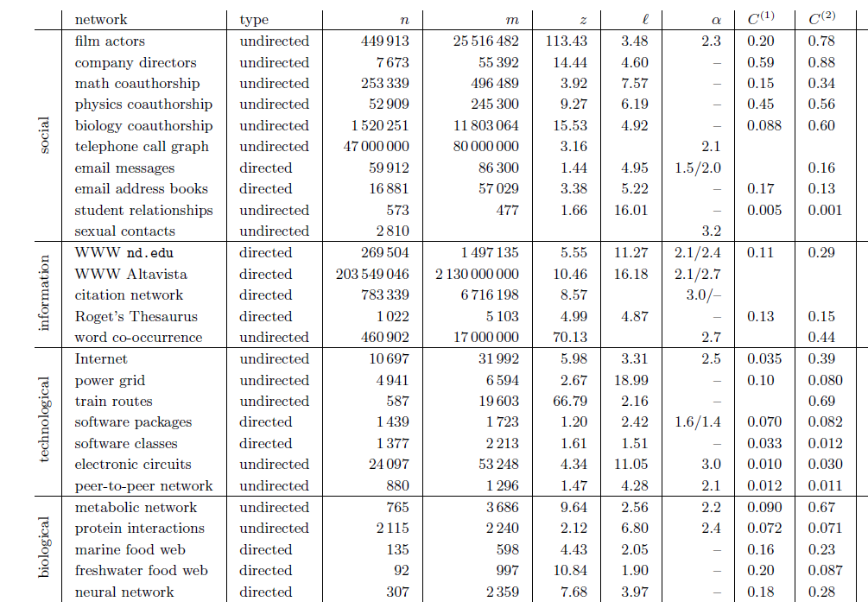
Notes:
Z (mean degree) of these various networks

Slide 19
Erdos-Renyi graphs
A good model of degree distribution in ”natural” networks?

Slide 20
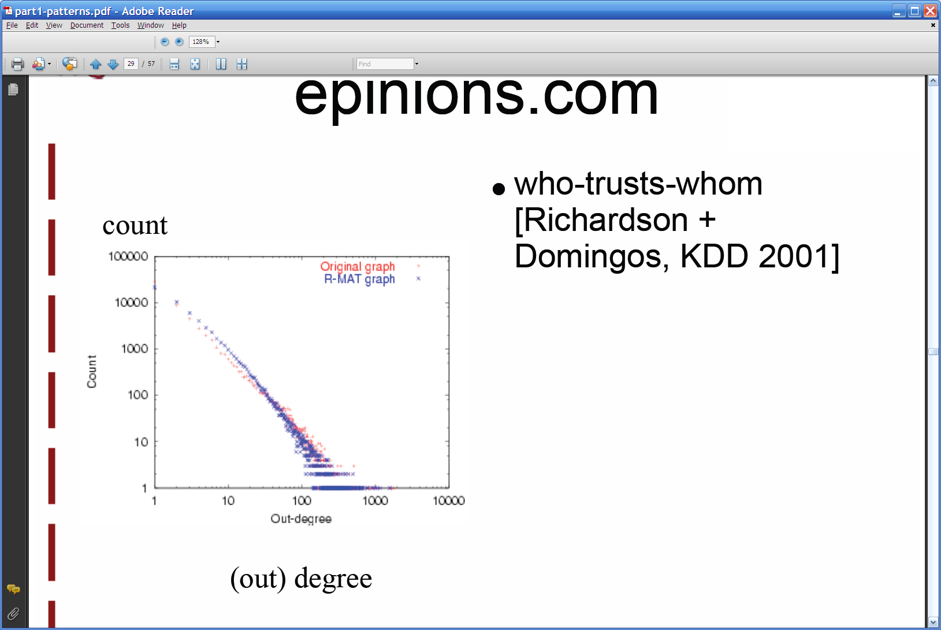
Degree distribution
Plot cumulative degree
X axis is degree
Y axis is #nodes that have degree at least k
Typically use a log-log scale
Straight lines are a power law; normal curve dives to zero at some point
Right: trust network in epinions web site from Richardson & Domingos

Slide 21
Degree distribution
Plot cumulative degree
X axis is degree
Y axis is #nodes that have degree at least k
Typically use a log-log scale
Straight lines are a power law; normal curve dives to zero at some point
This defines a “scale” for the network
Right: trust network in epinions web site from Richardson & Domingos

Slide 22
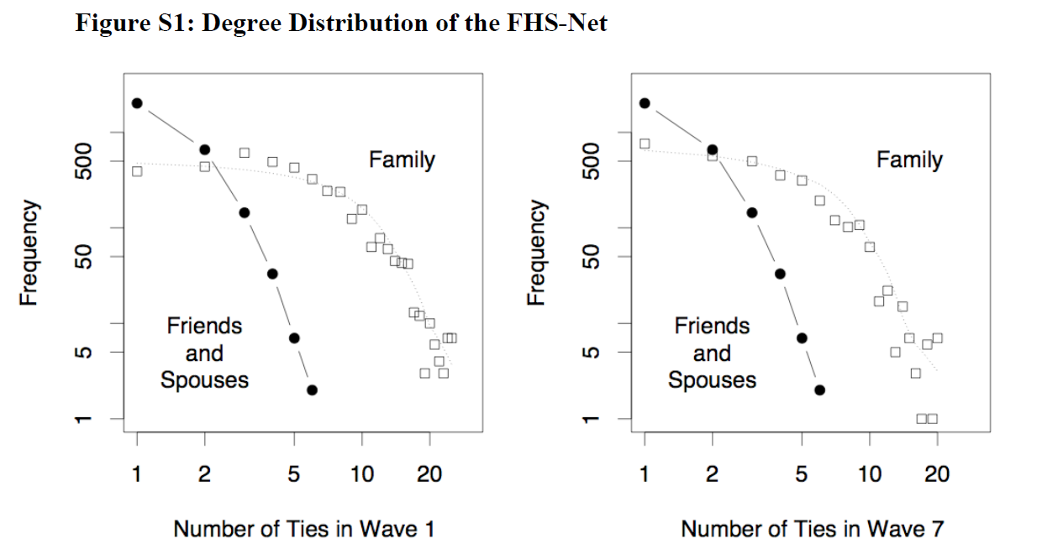
Friendship network in Framington Heart Study

Slide 23
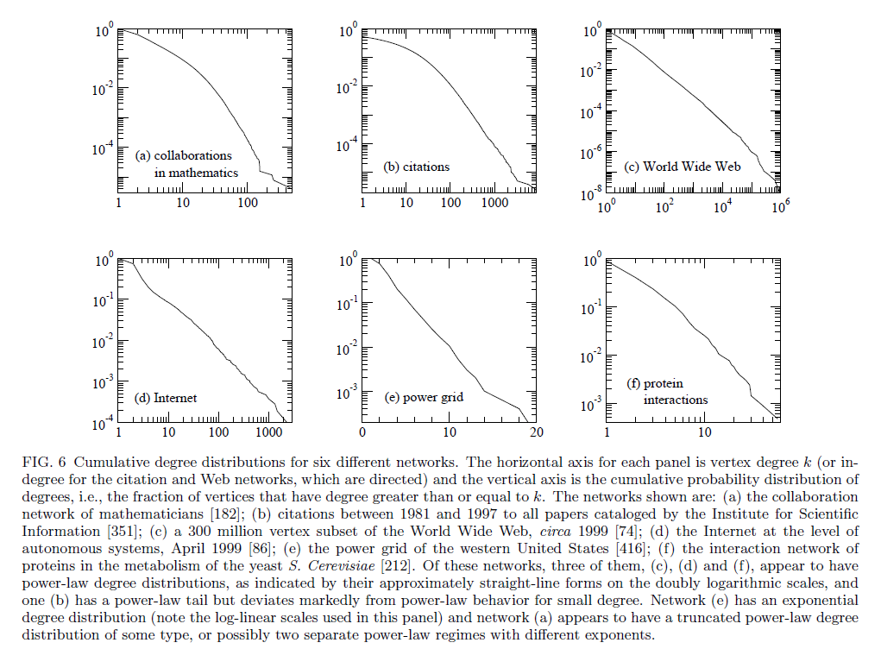

Slide 24
Notes:
Alpha – the negative exponent (power in the power law graph)

Slide 25
Graphs
Some common properties of graphs:
Distribution of node degrees
Distribution of cliques (e.g., triangles)
Distribution of paths
Diameter (max shortest-path)
Effective diameter (90th percentile)
Connected components
…
Some types of graphs to consider:
Real graphs (social & otherwise)
Generated graphs:
Erdos-Renyi “Bernoulli” or “Poisson”
Watts-Strogatz “small world” graphs
Barbosi-Albert “preferential attachment”
…

Slide 26
Graphs
Some common properties of graphs:
Distribution of node degrees: often scale-free
Distribution of cliques (e.g., triangles)
Distribution of paths
Diameter (max shortest-path)
Effective diameter (90th percentile) often small
Connected components usually one giant CC
…
Some types of graphs to consider:
Real graphs (social & otherwise)
Generated graphs:
Erdos-Renyi “Bernoulli” or “Poisson”
Watts-Strogatz “small world” graphs
Barbosi-Albert “preferential attachment” generates scale-free graphs
…

Slide 27
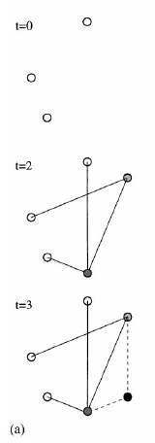
Barabasi-Albert Networks
Science 286 (1999)
Start from a small number of node, add a new node with m links
Preferential Attachment
Probability of these links to connect to existing nodes is proportional to the node’s degree
‘Rich gets richer’
This creates ‘hubs’: few nodes with very large degrees

Slide 28
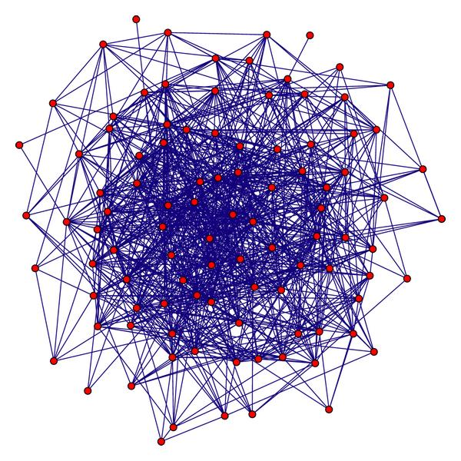
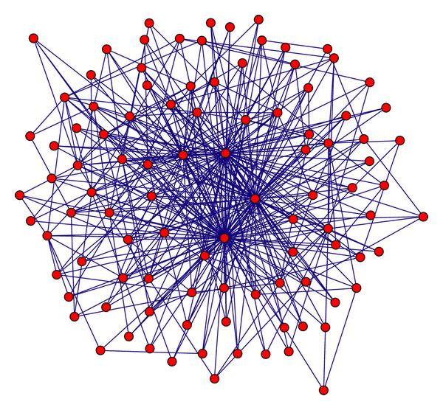
Random graph
(Erdos Renyi)
Preferential attachment
(Barabasi-Albert)
Notes:
Artificial graph

Slide 29
Graphs
Some common properties of graphs:
Distribution of node degrees: often scale-free
Distribution of cliques (e.g., triangles)
Distribution of paths
Diameter (max shortest-path)
Effective diameter (90th percentile) often small
Connected components usually one giant CC
…
Some types of graphs to consider:
Real graphs (social & otherwise)
Generated graphs:
Erdos-Renyi “Bernoulli” or “Poisson”
Watts-Strogatz “small world” graphs
Barbosi-Albert “preferential attachment” generates scale-free graphs
…

Slide 30
Homophily
One definition: excess edges between similar nodes
E.g., assume nodes are male and female and Pr(male)=p, Pr(female)=q.
Is Pr(gender(u)≠ gender(v) | edge (u,v)) >= 2pq?
Another definition: excess edges between common neighbors of v
Notes:
Closer this ratio is to 1, the more the neighbors of v are also connected to each other

Slide 31
Homophily
Another definition: excess edges between common neighbors of v

Slide 32
Homophily
In a random Erdos-Renyi graph:
Probably not realistic!
In a natural graph, two of your mutual friends might also be friends
Both in the same class or organization
You introduced them
They introduced you

Slide 33
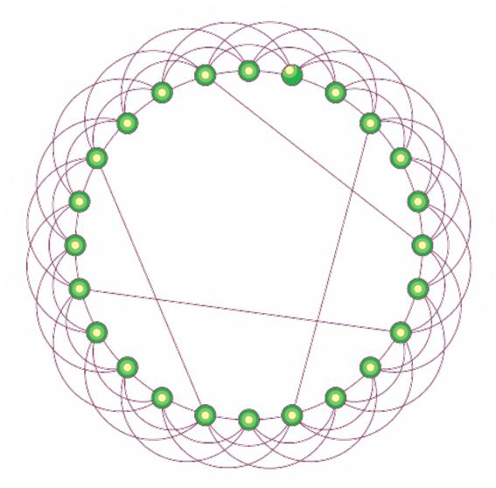
Watts-Strogatz model
Start with a ring
Connect each node to k nearest neighbors
➔ homophily
Add some random shortcuts from one point to another
➔ small diameter
Degree distribution not scale-free
Generalizes to d dimensions

Slide 34
Notes:
Social networks show a LOT more homophily than other types of networks

Slide 35
Google’s PageRank
Inlinks are “good” (recommendations)
Inlinks from a “good” site are better than inlinks from a “bad” site
but inlinks from sites with many outlinks are not as “good”...
“Good” and “bad” are relative.
web site xxx
web site xxx
web site xxx
web site a b c d e f g
web
site
pdq pdq ..
web site yyyy
web site a b c d e f g
web site yyyy

Slide 36
Google’s PageRank
web site xxx
Imagine a “pagehopper” that always either
follows a random link, or
jumps to random page
web site xxx
web site a b c d e f g
web
site
pdq pdq ..
web site yyyy
web site a b c d e f g
web site yyyy

Slide 37
Google’s PageRank (Brin & Page, http://www-db.stanford.edu/~backrub/google.html)
web site xxx
Imagine a “pagehopper” that always either
follows a random link, or
jumps to random page
PageRank ranks pages by the amount of time the pagehopper spends on a page:
or, if there were many pagehoppers, PageRank is the expected “crowd size”
web site xxx
web site a b c d e f g
web
site
pdq pdq ..
web site yyyy
web site a b c d e f g
web site yyyy

Slide 38
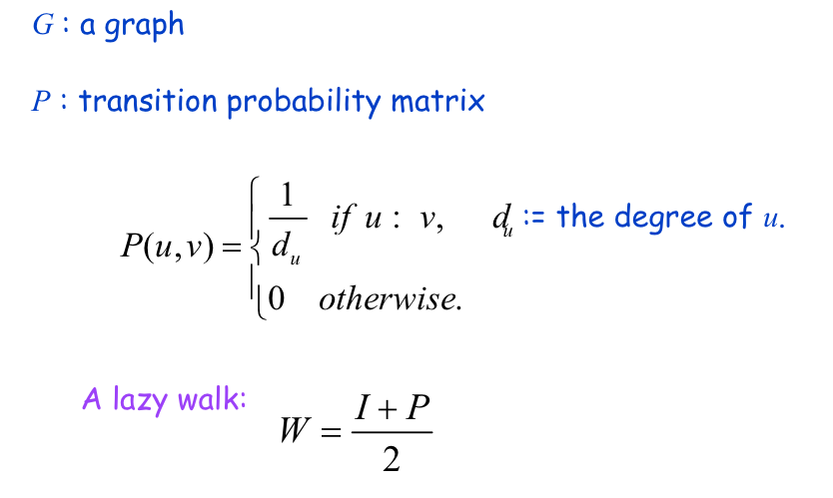
Random Walks
avoids messy “dead ends”….

Slide 39
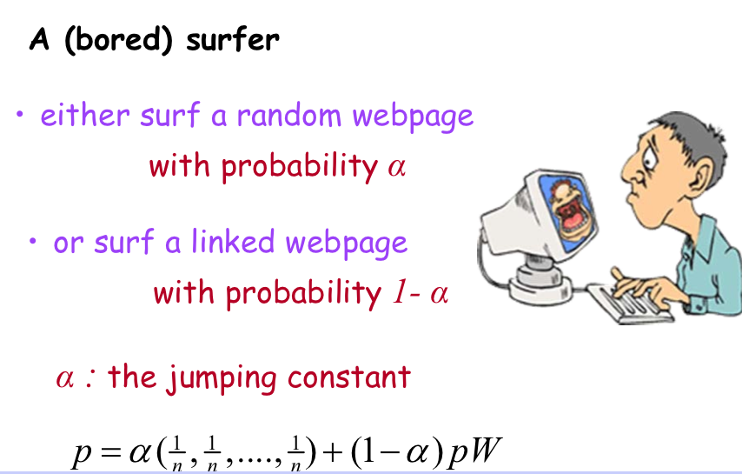
Random Walks: PageRank

Slide 40
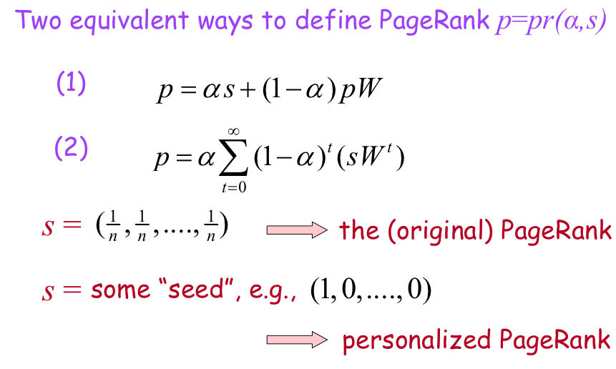
Random Walks: PageRank

Slide 41
Graph = Matrix Vector = Node → Weight
M
v
 | A | B | C | D | E | F | G | H | I | J
A | _ | 1 | 1 |  |  | 1
B | 1 | _ | 1
C | 1 | 1 | _
D |  |  |  | _ | 1 | 1
E |  |  |  | 1 | _ | 1
F | 1 |  |  | 1 | 1 | _
G |  |  |  |  |  |  | _ |  | 1 | 1
H |  |  |  |  |  |  |  | _ | 1 | 1
I |  |  |  |  |  |  | 1 | 1 | _ | 1
J |  |  |  |  |  |  | 1 | 1 | 1 | _
 | A
A | 3
B | 2
C | 3
D
E
F
G
H
I
J
C
A
B
G
I
H
J
F
D
E

Slide 42
PageRank
Let u = (1/N, …, 1/N)
dimension = #nodes N
Let A = adjacency matrix: [a_{ij}=1 ⬄ i links to j]
Let W = [w_{ij} = a_{ij}/outdegree(i)]
w_{ij} is probability of jump from i to j
Let v⁰ = (1,1,….,1)
or anything else you want
Repeat until converged:
Let v^{t+1} = cu + (1-c)Wv^{t}
c is probability of jumping “anywhere randomly”

Slide 43
Administrivia
How is Assignment 2 going?
Assignment 3 out today! (due in two weeks, on Oct 8)
Midterm exam date has changed
Now Thursday, Oct 10 (1-week pushback)
All lecture materials and homeworks are fair game
Less emphasis on guest lectures
Some multiple choice, some short answer, some programming
Next week
I will be out of town (again; sorry) Sunday through Wednesday
No office hours on Monday (I’ll be in meetings all day)
Guest lecturer on Tuesday (required attendance)
Workshops 3 & 4 (OpenCV & pandas)—send me your materials!

